Slide 1
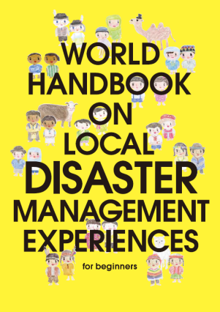
ICHARM disaster management handbook
Front page of English ver.
French + 10 ver.
Minoru Kamoto
Megumi Sugimoto ICHARM, Public Works Research Institute
Download URL:
http://www.icharm.pwri.go.jp

Slide 2
About disaster management handbook
The purpose of Handbook” is for sharing disaster lessons with people and mitigate all over the world
14 types of natural disaster are treated in the book.
1. Tsunami 8. Landslide,
2. Earthquake 9. Thunder & lightning,
3. Volcano 10. Tornado
4. Tropical cyclone 11. Snow& ice,
5. Storm surge 12. Drought,
6. Flood 13. Haze
7. Debris flow, 14. Fire
The author: Megumi SUGIMTO (Ph.D. in global environmental studies) in ICHARM
Reviewers: Prof. Nobuo Shuto in Tohoku University, Robert Geller in University of Tokyo, Prof. Masato Iguchi and top scientists in the world.
Cooperators: photos provided by researchers, DM mangers and etc.
We need your advice and corporation to adjust for your country situation.

Slide 4
Page of Tropical cyclone
Thank you for Han River Flood Control Office in cooperation

Slide 5
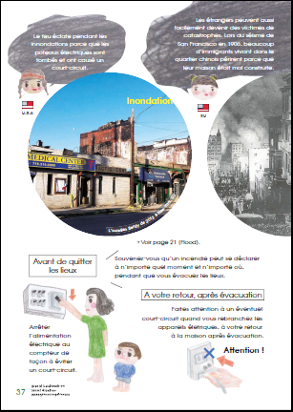
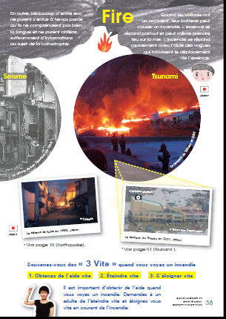

Slide 6
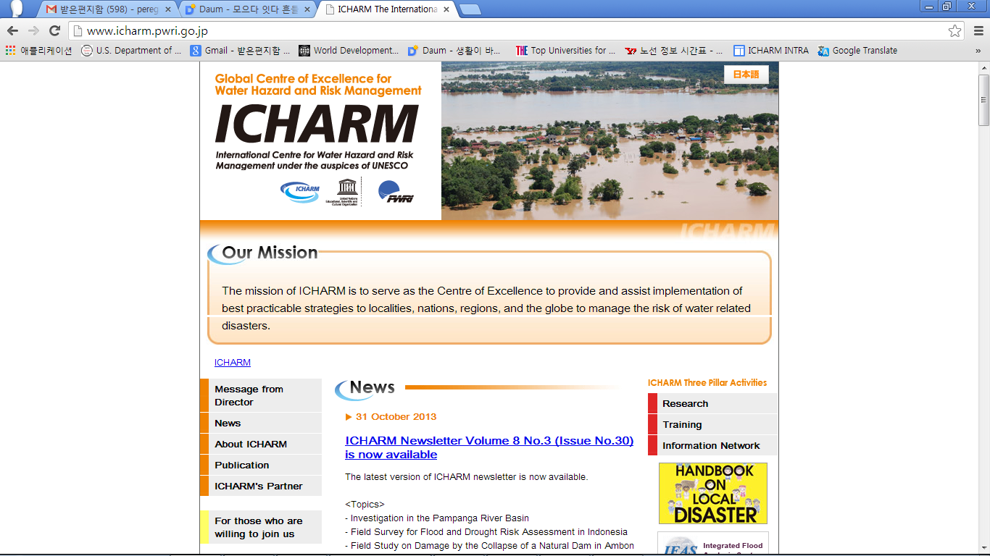
Please download the PDF and use freely excluding commercial use!
This is top page in ICHARM Homepage
http://www.icharm.pwri.go.jp
Click Yellow
top burner.

Slide 7
‘Malala Yousafzai Foundation’ deicide to distribute the handbook to Pakistan students through UNESCO
One pen, One book and one teacher can make a miracle.
Pakistan girl who was shot by Taliban was a candidate of Nobel piece prize in 2013

Slide 8
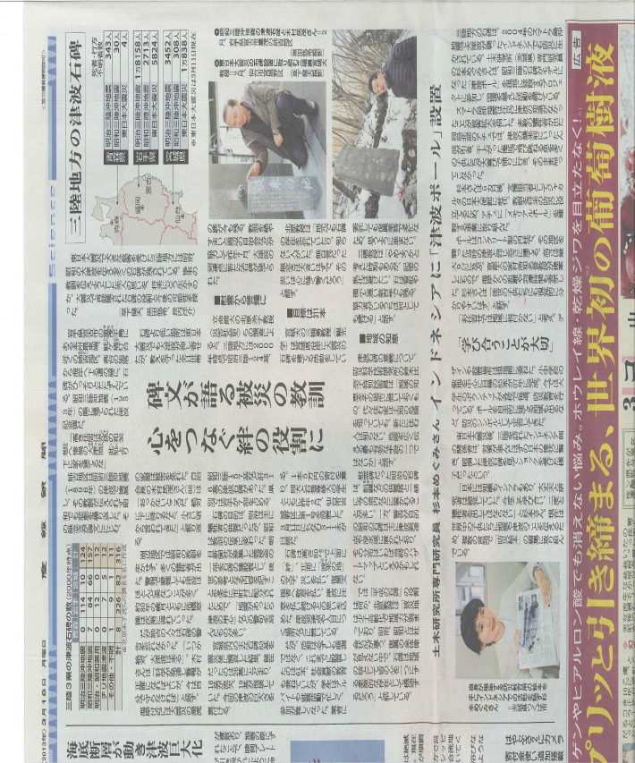
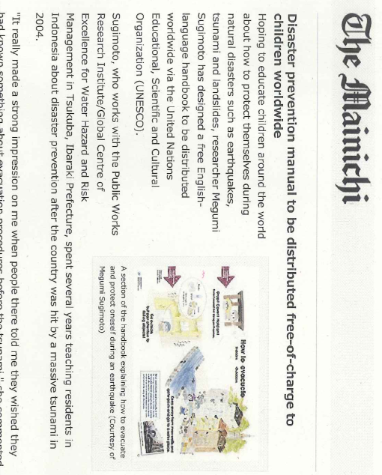
12 languages translation, medias introduced it, however…
English, Russian, French, Spanish, Arabic, Chinese, Portugal, Indonesian, Malay, Tetung (East Timor), Swahili and Urdu
UNESCO-ICHARM cannot cover all
budget for reprinting the book all over the world. We look for donors.
The Mainichi Newspapers
(May. 20, 2013)
Sankei News paper (Mar.18, 2013)

Slide 9
Thank you

